Slide 1

ANALYTICS BUSINESS INTELLIGENCE PROJECT:- CREDIT BANKRUPTCY
SUBMITTED BY:-
Anjali Dembla(ad1704)
GUIDED BY:-
Prof. Nuria Diaz-Tena

Slide 2

AGENDA
Problem Statement
Model
Results and Calculations
Finding the best model

Slide 3

PROBLEM STATEMENT
To Estimate Predictions of "default" using at least: logistic, LDA, QDA, decision trees, and KNN models using credit dataset. Select the best model to sell the financial institution

Slide 4

1.LOGISTIC REGRESSION
Logistic regression is a classification algorithm used to find the probability of event success and event failure. Logistic regression is used when the dependent variable is binary(0/1, True/False, Yes/No) in nature.
CODE:-
mod_log_t2 <- train(default ~ checking_balance + months_loan_duration + credit_history + purpose + amount + savings_balance + employment_duration + percent_of_income + years_at_residence + age , data=training, method="glm", family="binomial",metric = "Accuracy“,trControl = control, preProcess = preproc)
summary(mod_log_t2)
pred_log_t2 = predict(mod_log_t2, newdata=testing)
confusionMatrix(data=pred_log_t2, testing$default, mode = 'prec_recall')

Slide 5
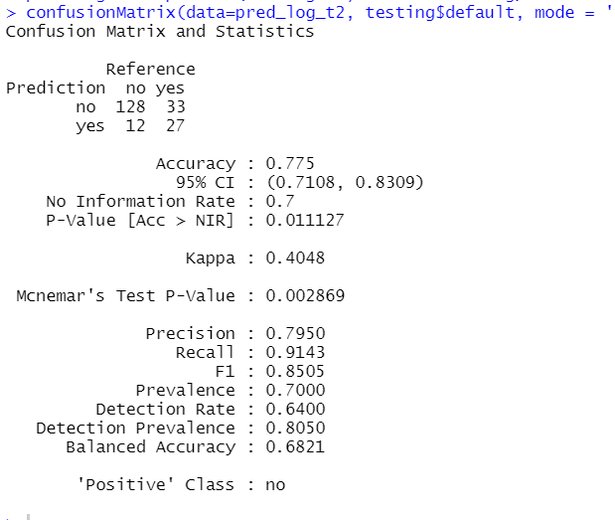
Output:-

Slide 6
Trial Values:-
Measures defined by the banker
No. of Clients | 5000
Default Rate | 10%
Average Default | 200000
Payments | 20000

Slide 7
CALCULATIONS
LOGISTIC MODEL
Confusion Matrix | Predicted | Predicted | Total
 | 1 | 0
Actually 1 | 457 | 43 | 500
Actually 0 | 1,082 | 3,418 | 4,500
Total | 1,539 | 3,461 | 5,000
Recall | 91% | (From the model results)
Accuracy | 78% | (From the model results)
Precision | 30%
F1 | 61%
Profits without Model |  | Losses incurred | ($100,000,000.00)
 |  | Payments received | $90,000,000.00
 |  | Profits | ($10,000,000.00)
Profits with Model |  | Losses incurred | ($8,600,000.00)
 |  | Payments received | $68,360,000.00
 |  | Profits | $59,760,000.00
 | BENEFIT OF THE MODEL |  | $69,760,000.00

Slide 8
2.LDA MODEL
It’s a well established Machine Learning technique , Linear Discriminant Analysis (LDA ). It is mainly used to solve classification problems rather than supervised classification problems. It is basically a dimensionality reduction technique. Using the Linear combinations of predictors, LDA tries to predict the class of the given observations
CODE:-
########################## LDA MODEL ##########################
mod_lda <- train(default ~ checking_balance + months_loan_duration + credit_history + purpose+ amount + savings_balance + employment_duration + percent_of_income+ years_at_residence + age + other_credit + housing + existing_loans_count + job + dependents + phone,
data = training, method = "lda", family="binomial",
metric = "Accuracy", trControl = control, preProcess = preproc) mod_lda
pred_lda = predict(mod_lda, newdata=testing)
confusionMatrix(data=pred_lda, testing$default, mode = 'prec_recall')

Slide 9
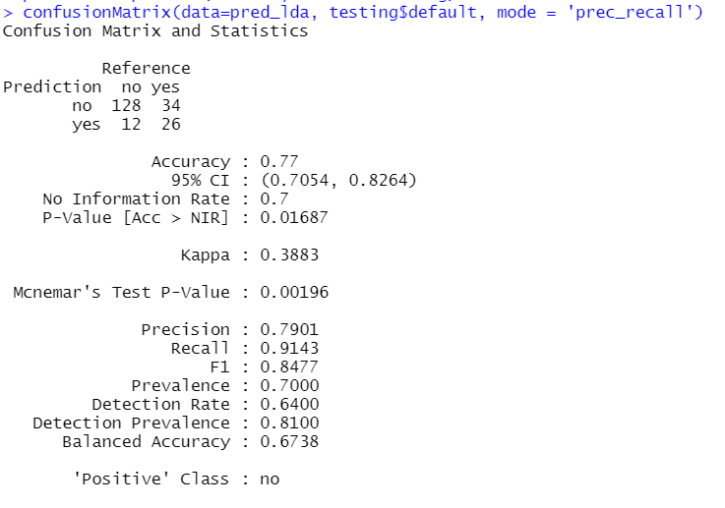
Output:-

Slide 10
CALCULATIONS
LDA MODEL
Confusion Matrix | Predicted | Predicted | Total
 | 1 | 0
Actually 1 | 455 | 45 | 500
Actually 0 | 1,105 | 3,395 | 4,500
Total | 1,560 | 3,440 | 5,000
Recall | 91% | (From the model results)
Accuracy | 77% | (From the model results)
Precision | 29%
F1 | 60%
Profits without Model |  | Losses incurred | ($100,000,000.00)
 |  | Payments received | $90,000,000.00
 |  | Profits | ($10,000,000.00)
Profits with Model |  | Losses incurred | ($9,000,000.00)
 |  | Payments received | $67,900,000.00
 |  | Profits | $58,900,000.00
 | BENEFIT OF THE MODEL |  | $68,900,000.00

Slide 11
3.QDA MODEL
Quadratic Discriminant Analysis (QDA) is a generative model.
QDA assumes that each class follow a Gaussian distribution.
CODE:-
mod_qda <- train(default ~ checking_balance + months_loan_duration + credit_history + purpose+ amount + savings_balance + employment_duration + percent_of_income
+ years_at_residence + age + other_credit + housing + existing_loans_count
+ job + dependents + phone,
data = training, method = "qda", family="binomial",
metric = "Accuracy", trControl = control, preProcess = preproc)
mod_qda
pred_qda = predict(mod_qda, newdata=testing)
confusionMatrix(data=pred_qda, testing$default, mode = 'prec_recall')

Slide 12
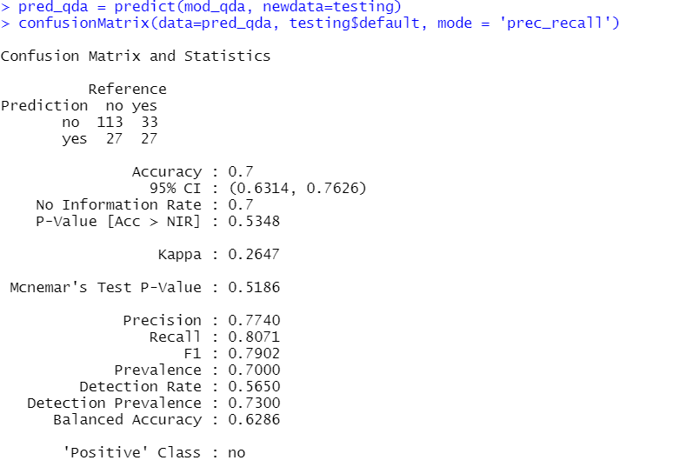
Output:-

Slide 13
QDA MODEL
Confusion Matrix | Predicted | Predicted | Total
 | 1 | 0
Actually 1 | 400 | 100 | 500
Actually 0 | 1,400 | 3,100 | 4,500
Total | 1,800 | 3,200 | 5,000
Recall | 80% | (From the model results)
Accuracy | 70% | (From the model results)
Precision | 22%
F1 | 51%
Profits without Model |  | Losses incurred | ($100,000,000.00)
 |  | Payments received | $90,000,000.00
 |  | Profits | ($10,000,000.00)
Profits with Model |  | Losses incurred | ($20,000,000.00)
 |  | Payments received | $62,000,000.00
 |  | Profits | $42,000,000.00
 | BENEFIT OF THE MODEL |  | $52,000,000.00

Slide 14
4.KNN
K-Nearest Neighbours(KNN) is one of the most basic yet essential classification algorithms in Machine Learning. It belongs to the supervised learning domain and finds intense application in pattern recognition, data mining and intrusion detection. CODE:-
mod_knn <- train(default ~ checking_balance + months_loan_duration + credit_history + purpose+ amount + savings_balance + employment_duration + percent_of_income
+ years_at_residence + age + other_credit + housing + existing_loans_count
+ job + dependents + phone,
data = training, method = "knn",
metric = "Accuracy",
trControl = control, preProcess = preproc, tuneLength = 20)
summary(mod_knn)
pred_knn = predict(mod_knn, newdata=testing)
confusionMatrix(data=pred_knn, testing$default, mode = 'prec_recall')

Slide 15
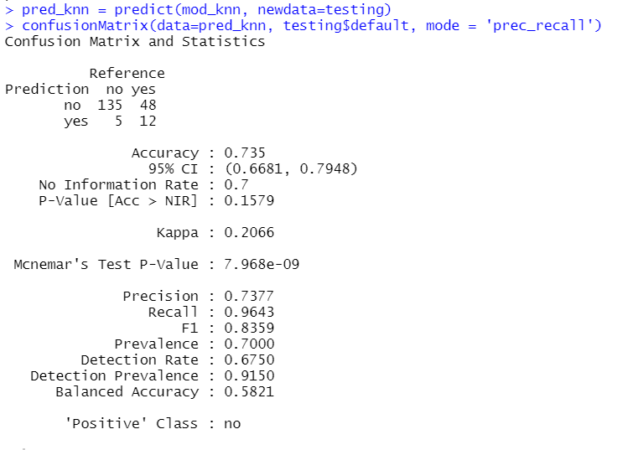
Output:-

Slide 16
KNN MODEL
Confusion Matrix | Predicted | Predicted | Total
 | 1 | 0
Actually 1 | 489 | 11 | 500
Actually 0 | 1,364 | 3,136 | 4,500
Total | 1,853 | 3,147 | 5,000
Recall | 98% | (From the model results)
Accuracy | 73% | (From the model results)
Precision | 26%
F1 | 62%
Profits without Model |  | Losses incurred | ($100,000,000.00)
 |  | Payments received | $90,000,000.00
 |  | Profits | ($10,000,000.00)
Profits with Model |  | Losses incurred | ($2,200,000.00)
 |  | Payments received | $62,720,000.00
 |  | Profits | $60,520,000.00
 | BENEFIT OF THE MODEL |  | $70,520,000.00

Slide 17
5.TREE
A tree has many analogies in real life, and turns out that it has influenced a wide area of machine learning, covering both classification and regression. In decision analysis, a decision tree can be used to visually and explicitly represent decisions and decision making. As the name goes, it uses a tree-like model of decisions
CODE:-
mod_tree = train(default ~ checking_balance + months_loan_duration + credit_history + purpose+ amount + savings_balance + employment_duration + percent_of_income+ years_at_residence + age + other_credit + housing + existing_loans_count+ job + dependents + phone,
data=training,
method="rpart", parms = list(split="gini"), metric = "Accuracy", trControl = control, tuneLength = 20)
mod_tree
pred_tree = predict(mod_tree, newdata=testing)
confusionMatrix(data=pred_tree, testing$default, mode = 'prec_recall')

Slide 18
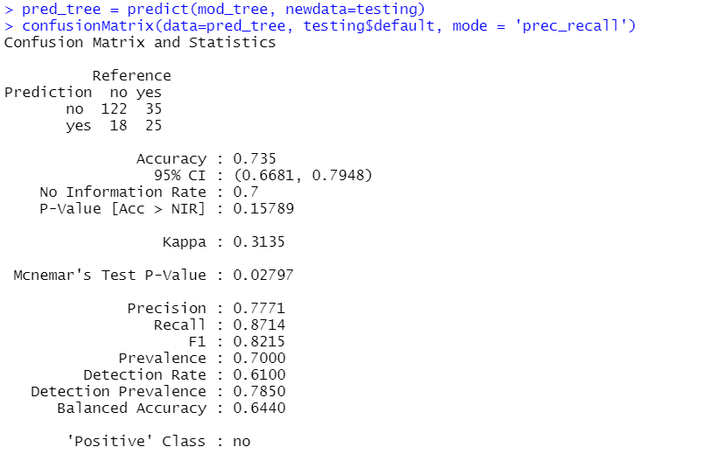
Output:-

Slide 19
Tree MODEL
Confusion Matrix | Predicted | Predicted | Total
 | 1 | 0
Actually 1 | 435 | 65 | 500
Actually 0 | 1,260 | 3,240 | 4,500
Total | 1,695 | 3,305 | 5,000
Recall | 87% | (From the model results)
Accuracy | 74% | (From the model results)
Precision | 26%
F1 | 56%
Profits without Model |  | Losses incurred | ($100,000,000.00)
 |  | Payments received | $90,000,000.00
 |  | Profits | ($10,000,000.00)
Profits with Model |  | Losses incurred | ($13,000,000.00)
 |  | Payments received | $64,800,000.00
 |  | Profits | $51,800,000.00
 | BENEFIT OF THE MODEL |  | $61,800,000.00

Slide 20

THANK YOU

